Slide 1
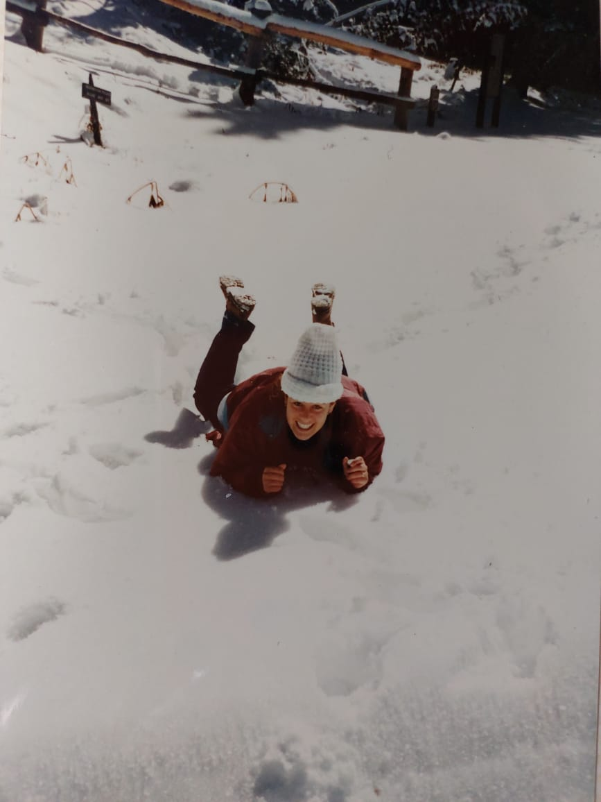


Slide 2
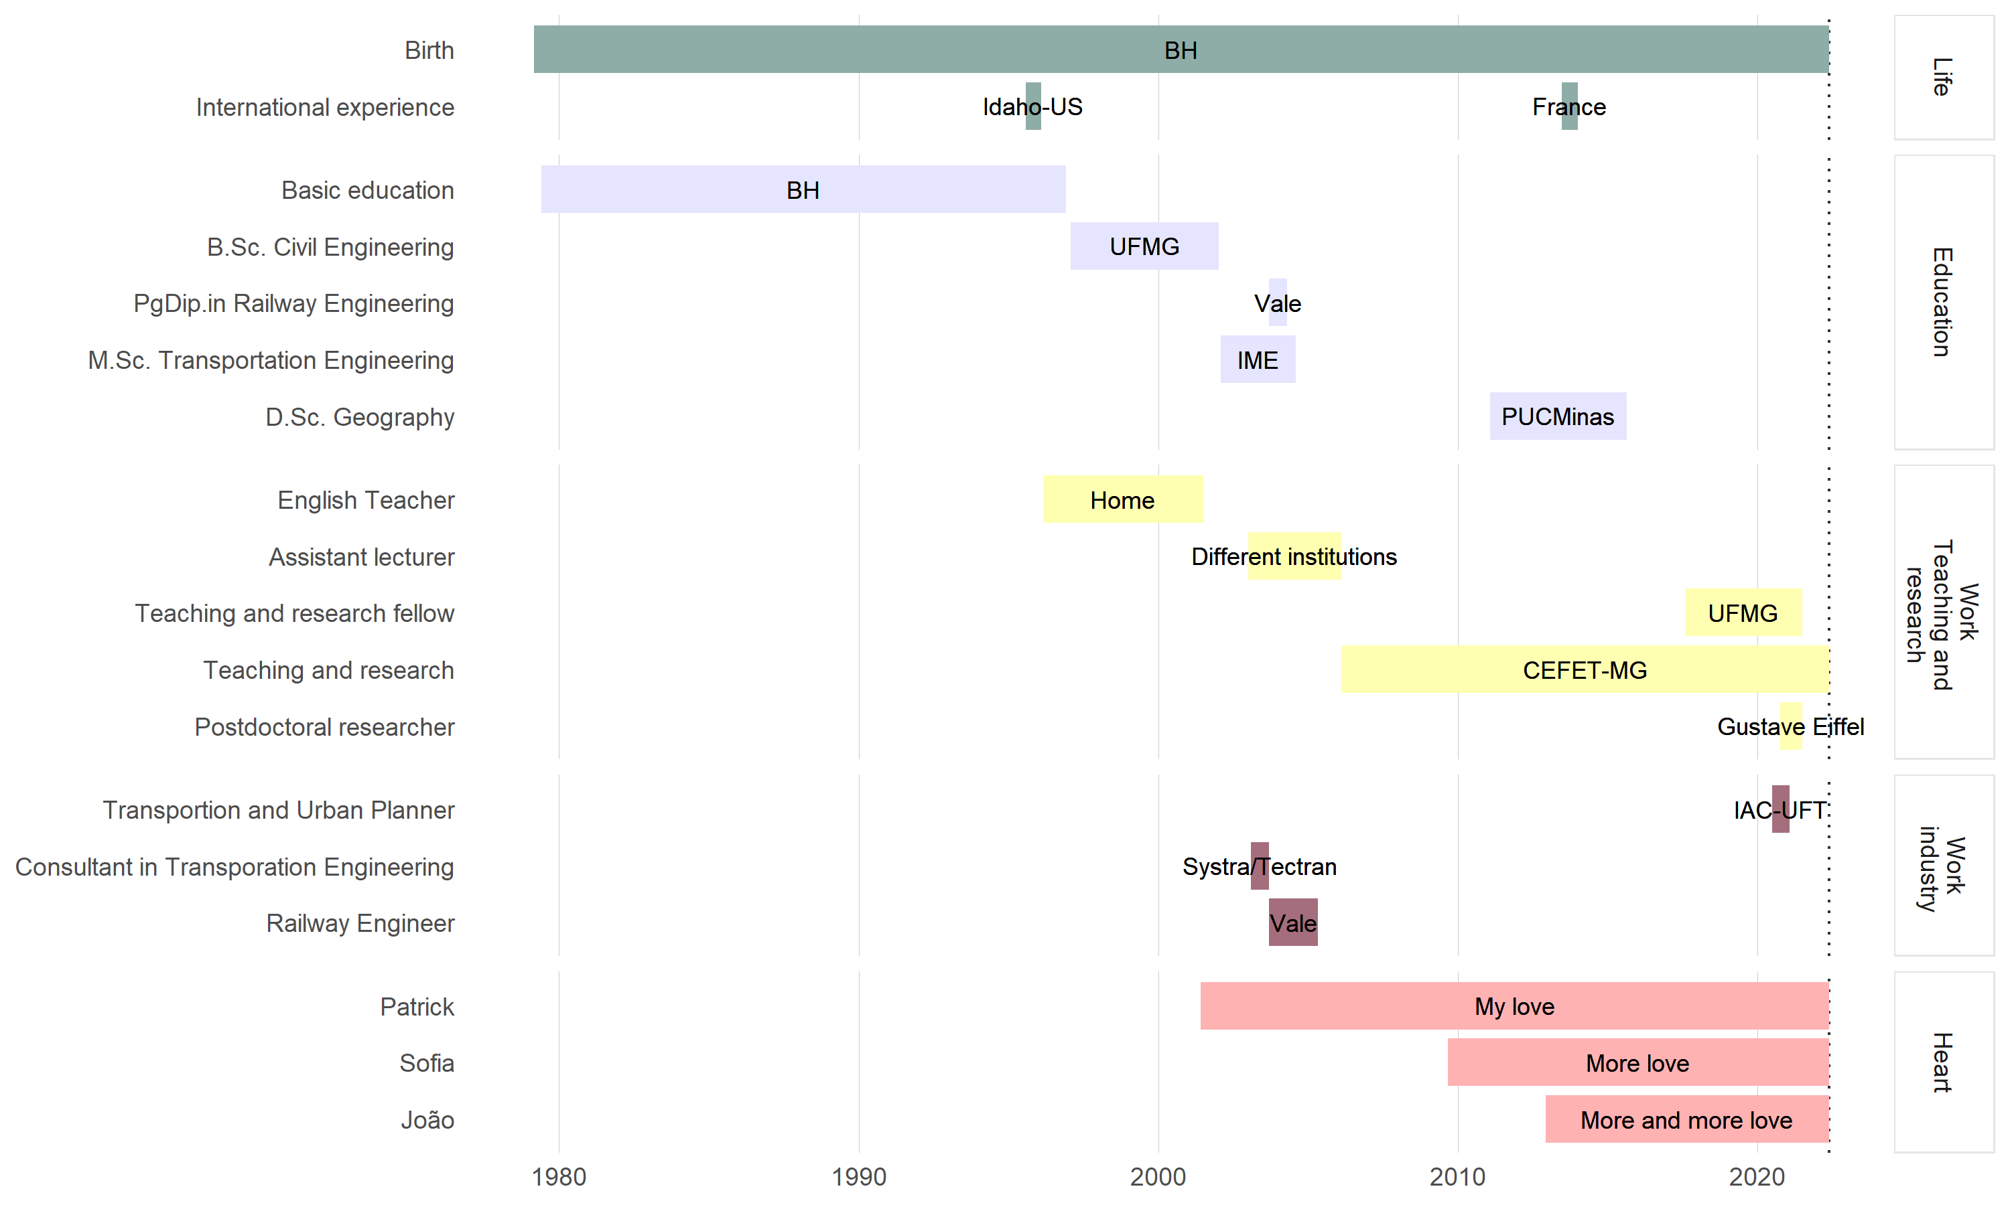
Understanding the world
Learning and teaching
Producing and
sharing knowledge for a better world

Slide 3
Understanding the world

Slide 4
Learning and teaching

Slide 5
Producing and
sharing knowledge for a better world

Slide 7
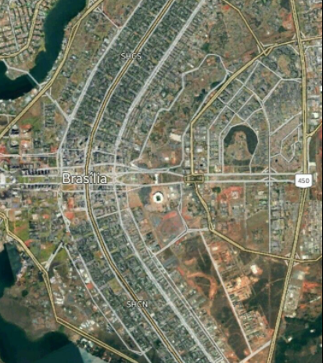
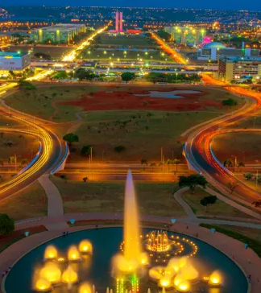

Slide 8
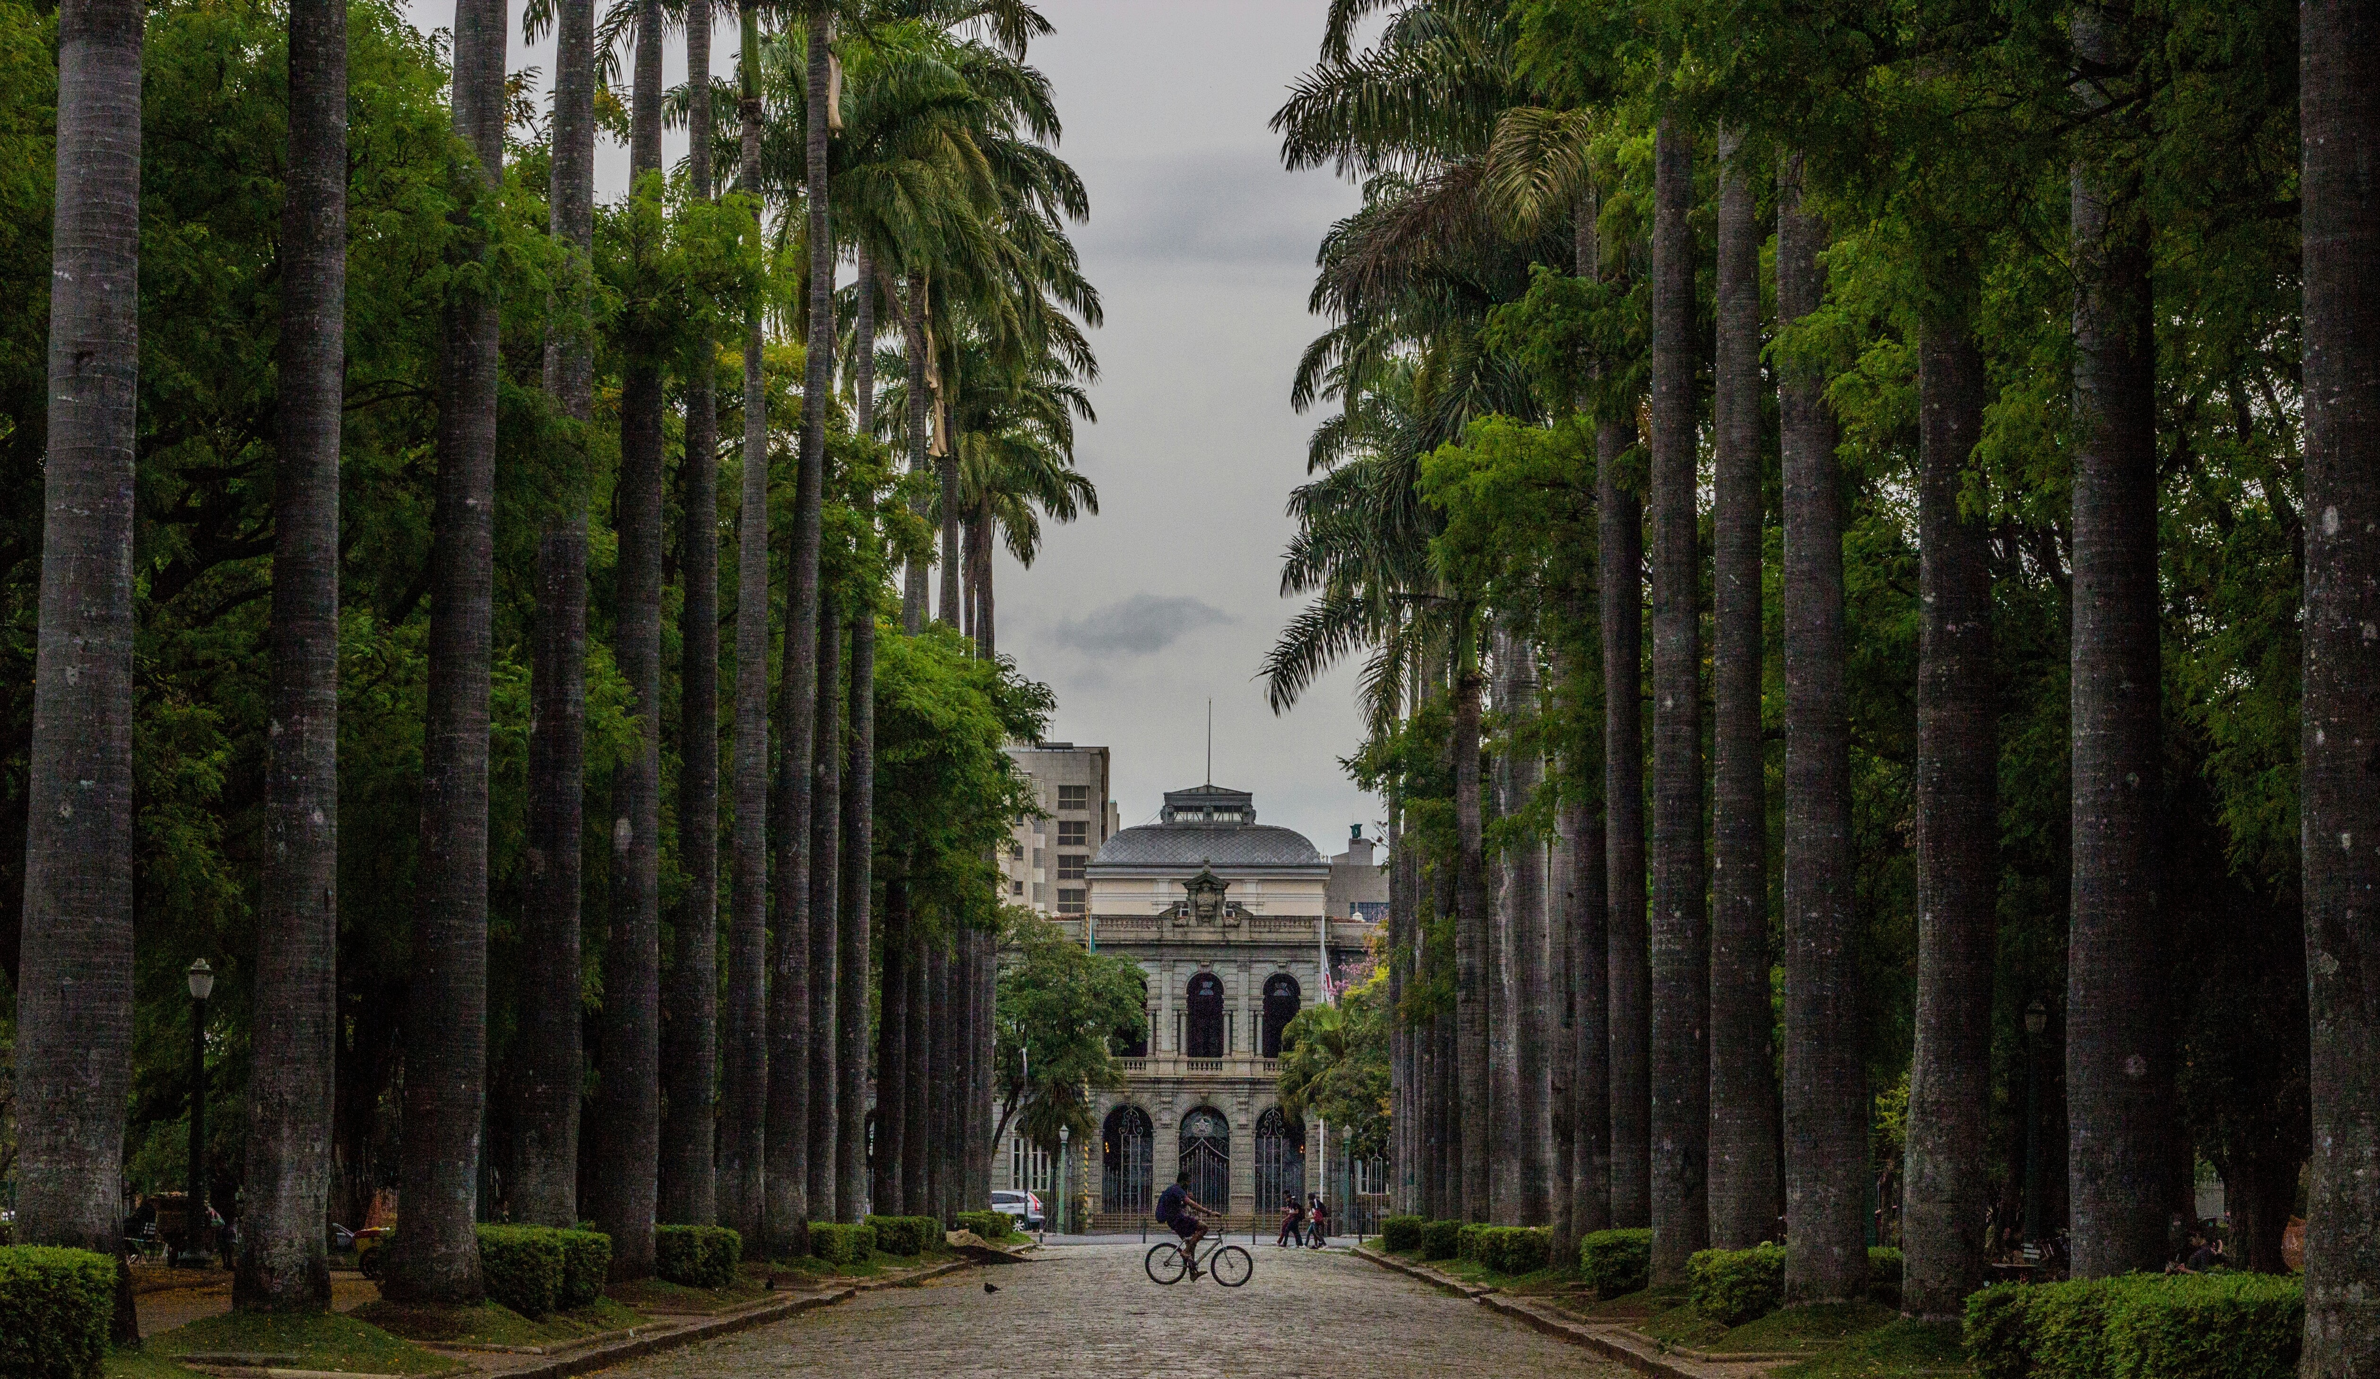

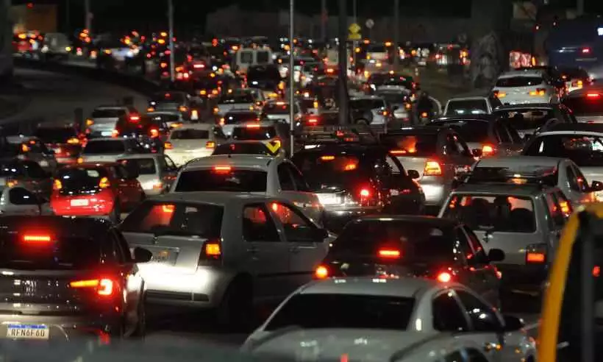
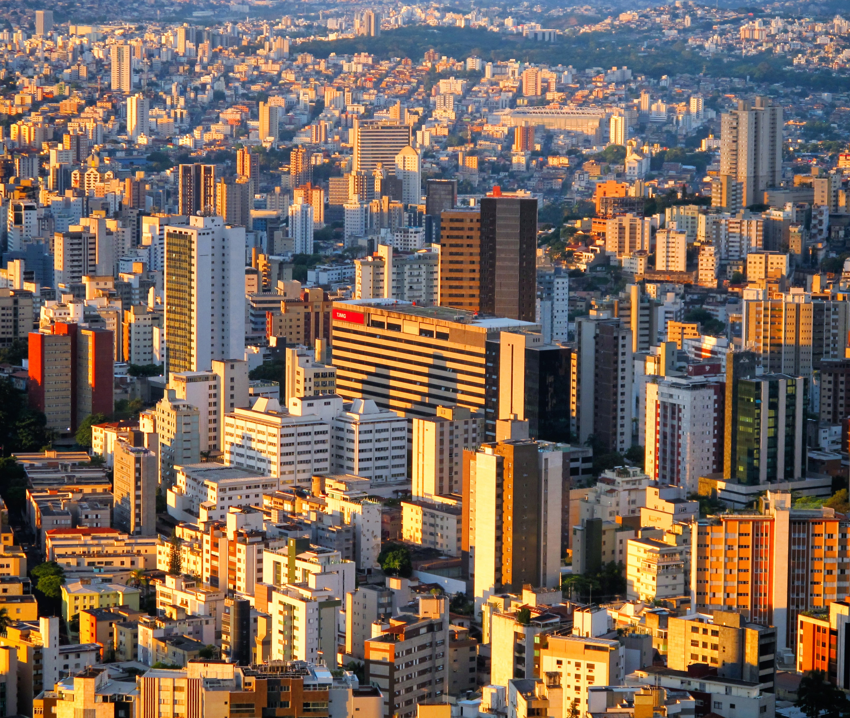
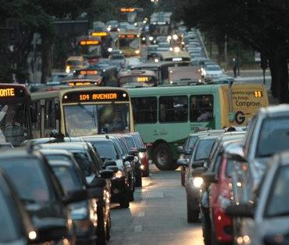

Slide 9
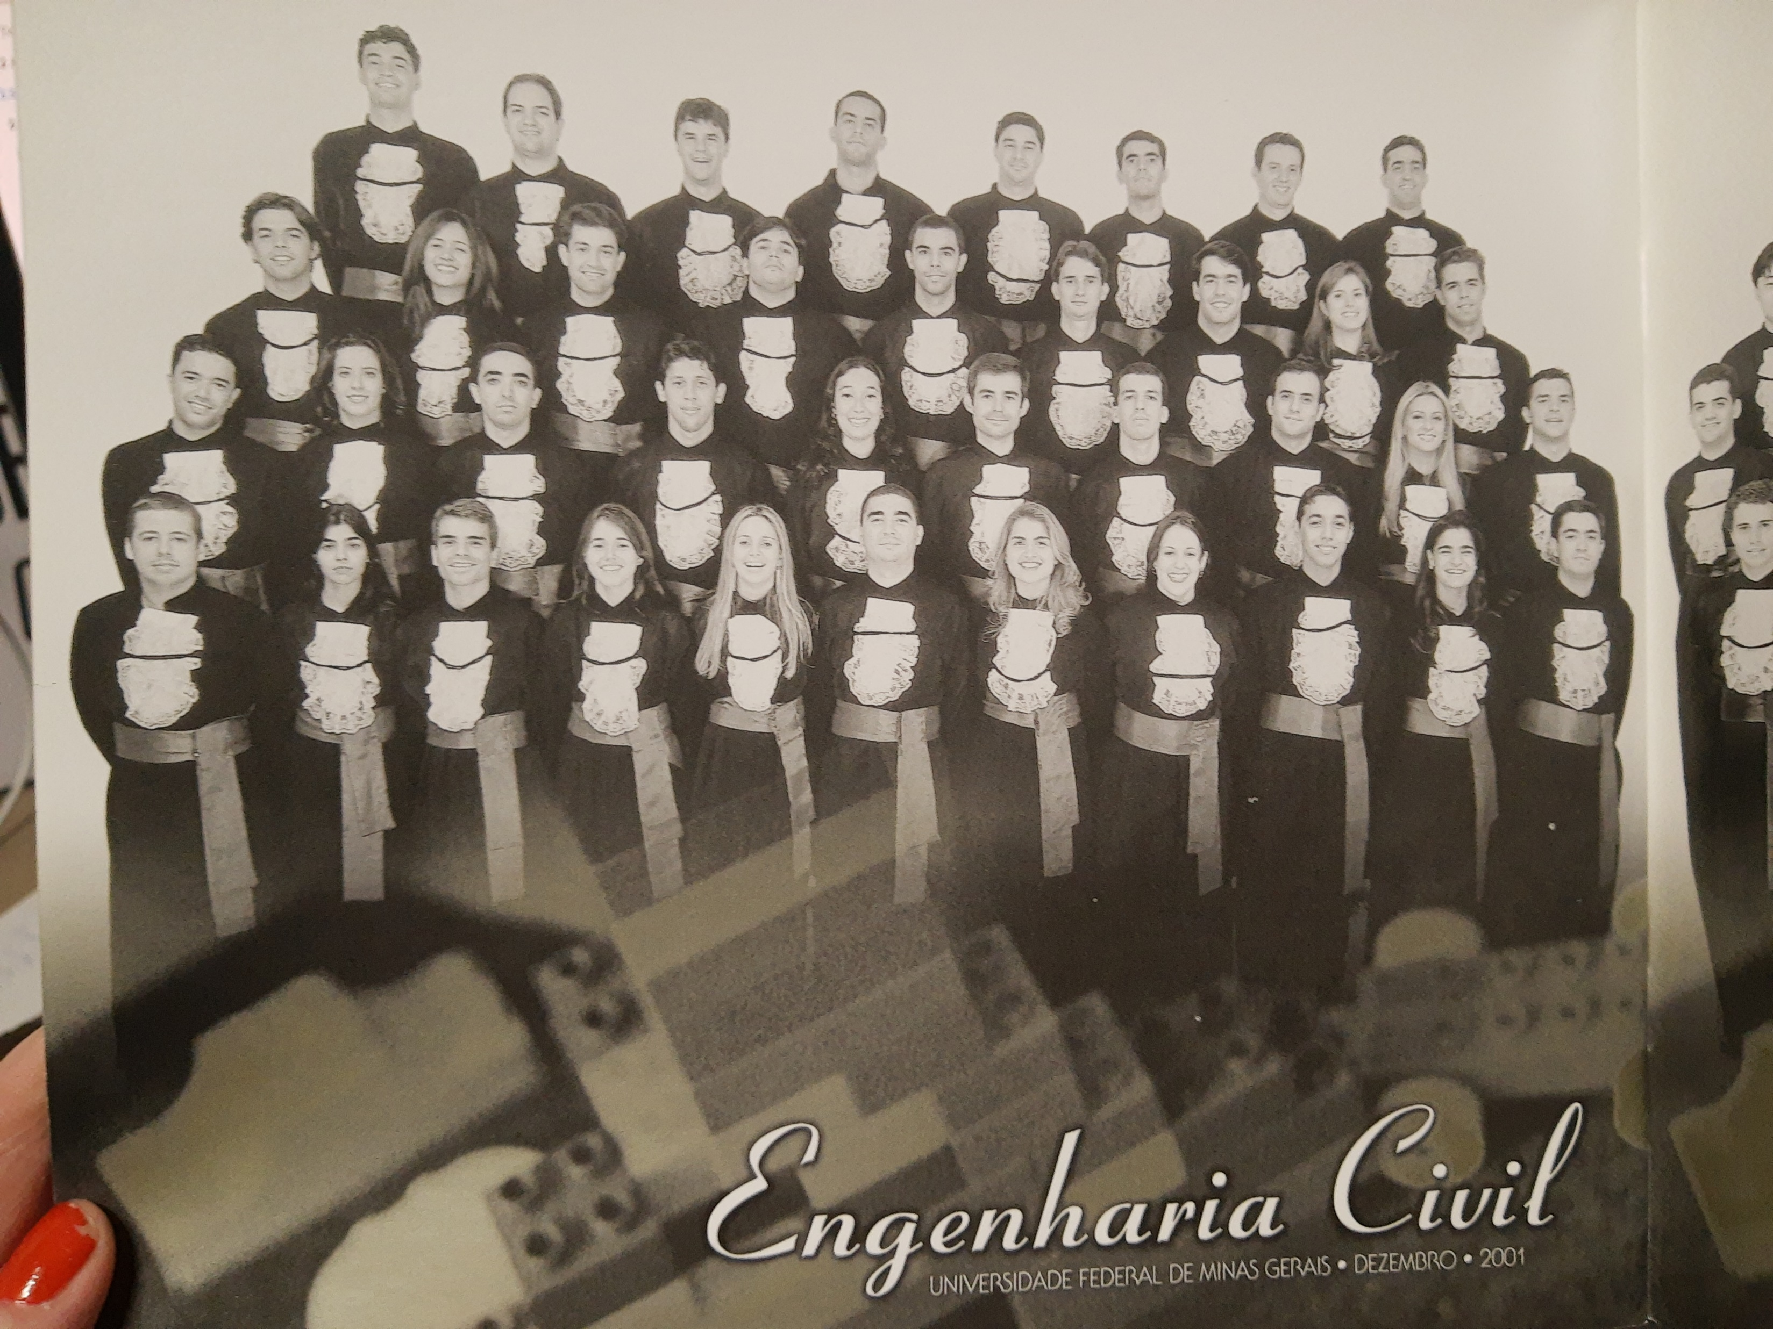

Slide 11
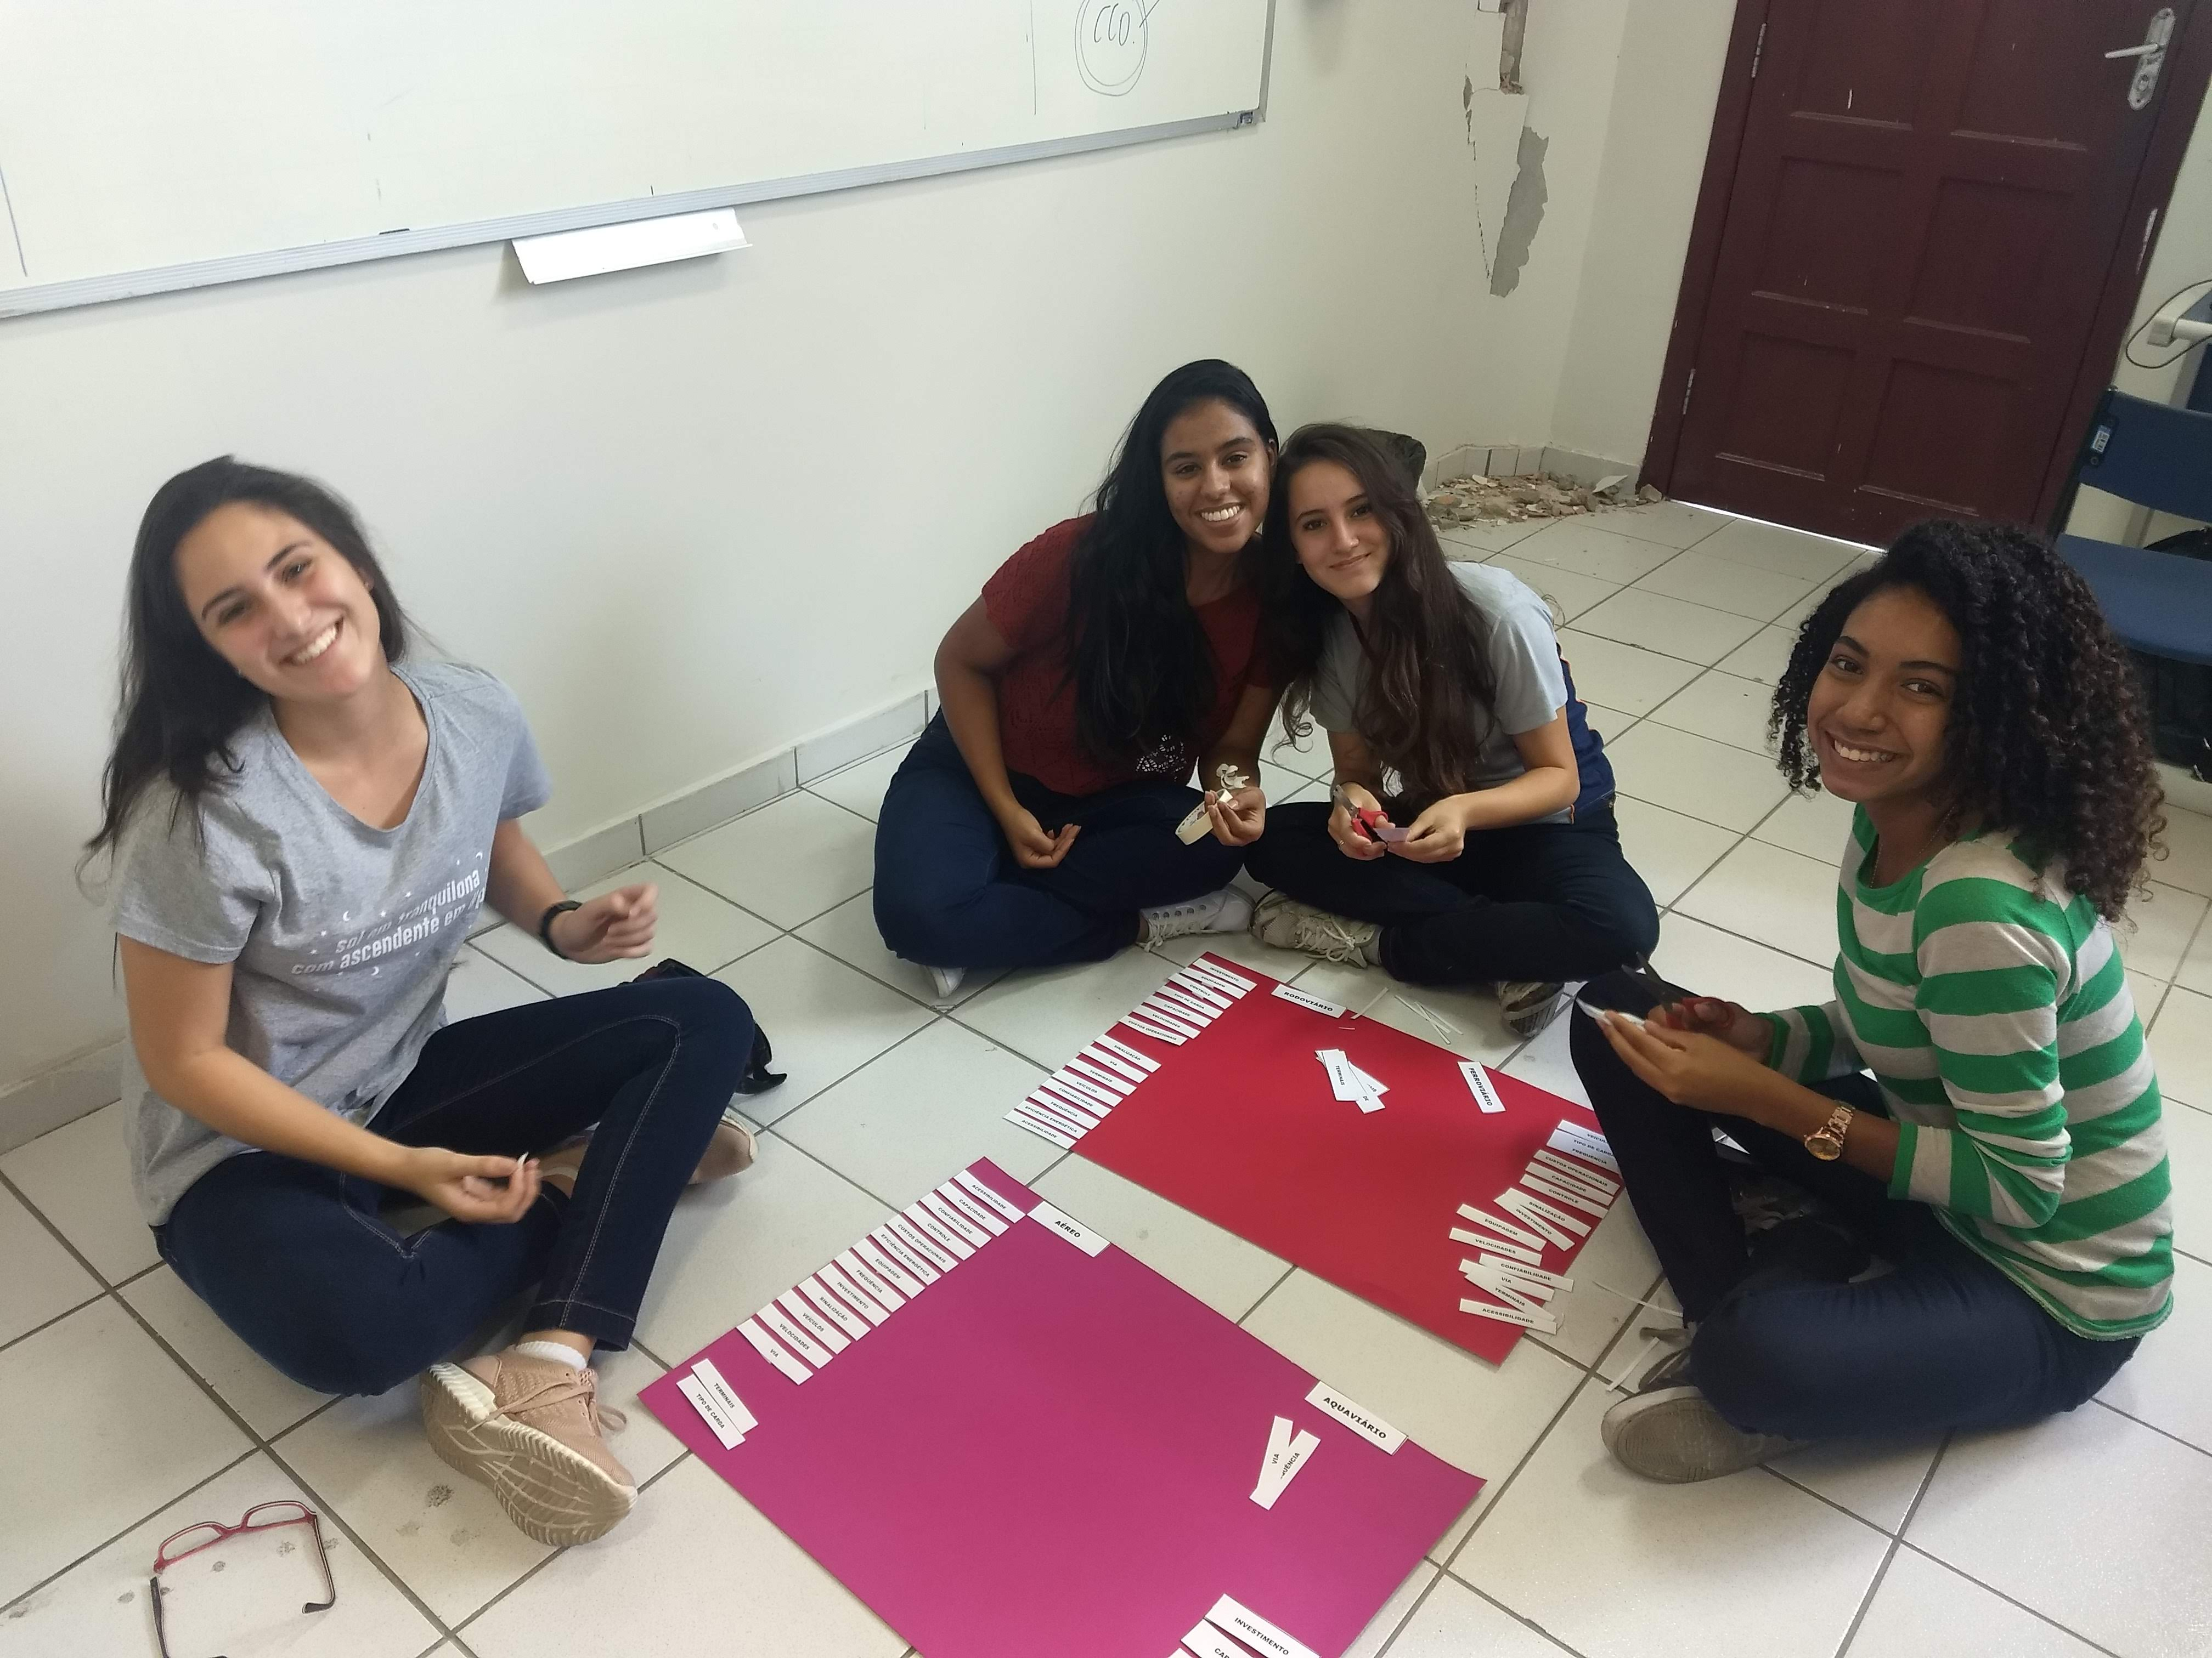
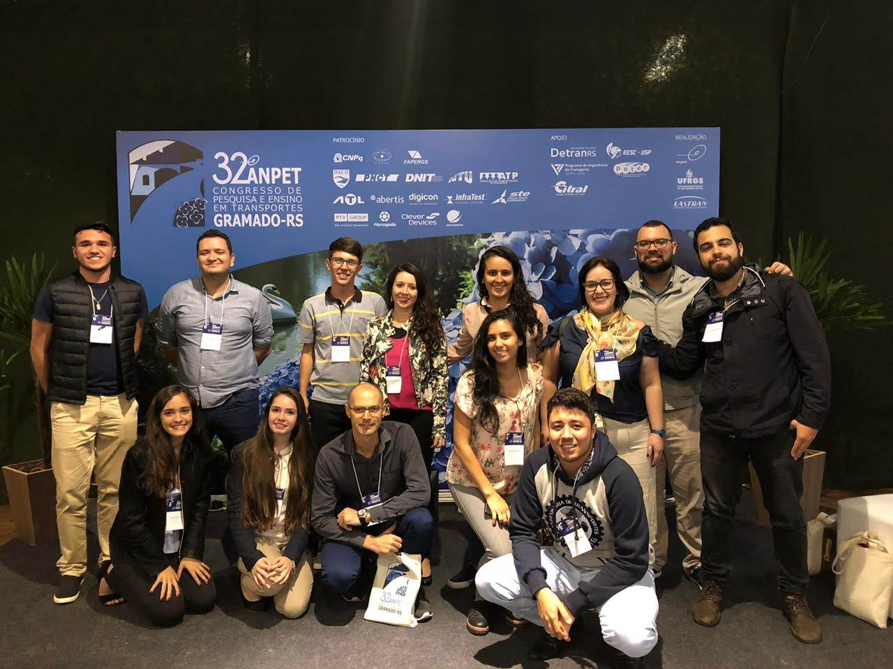
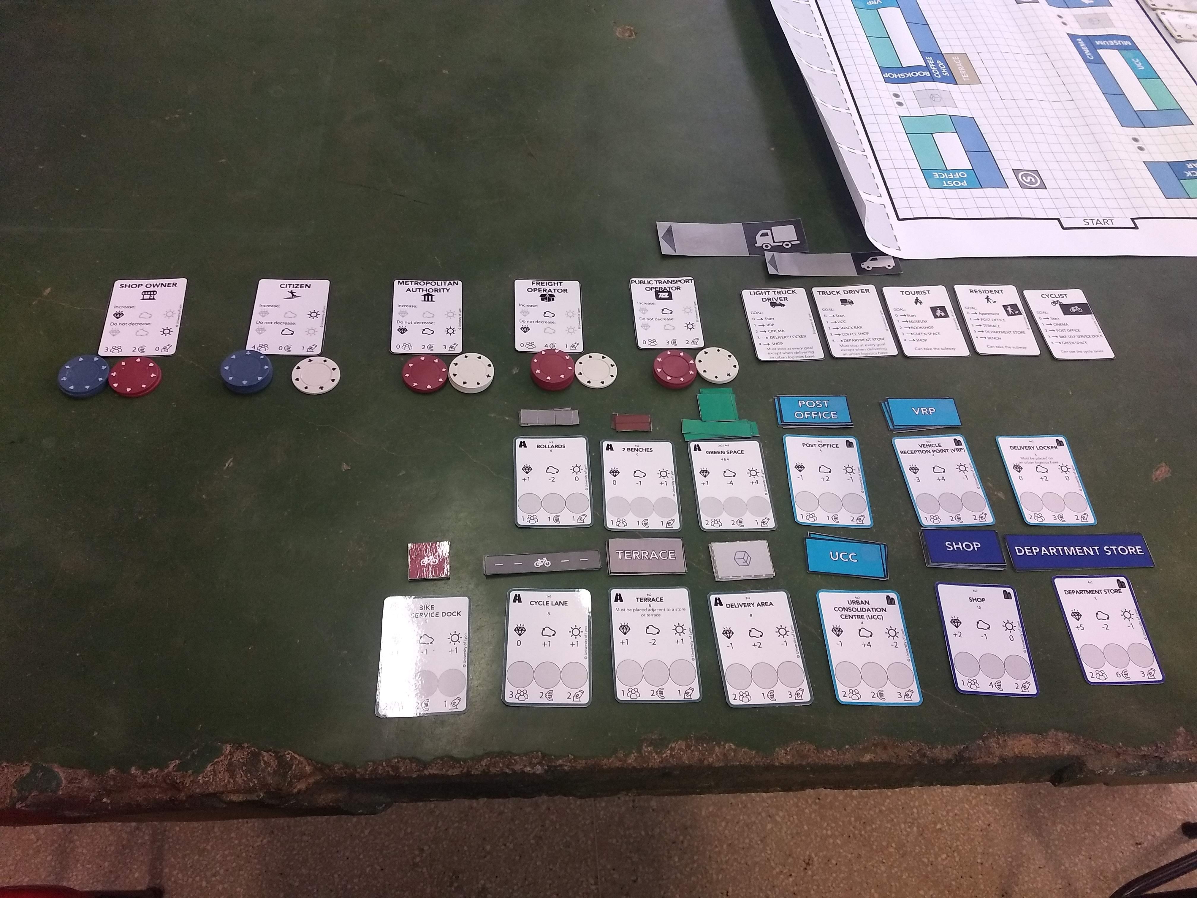
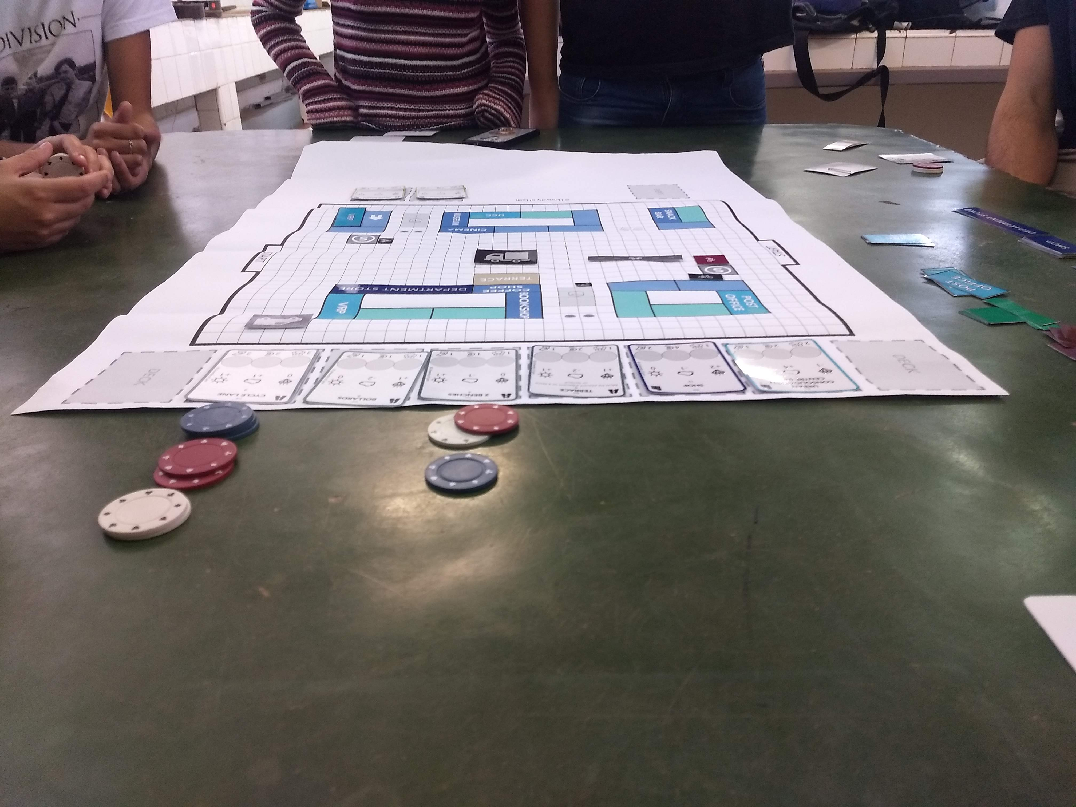
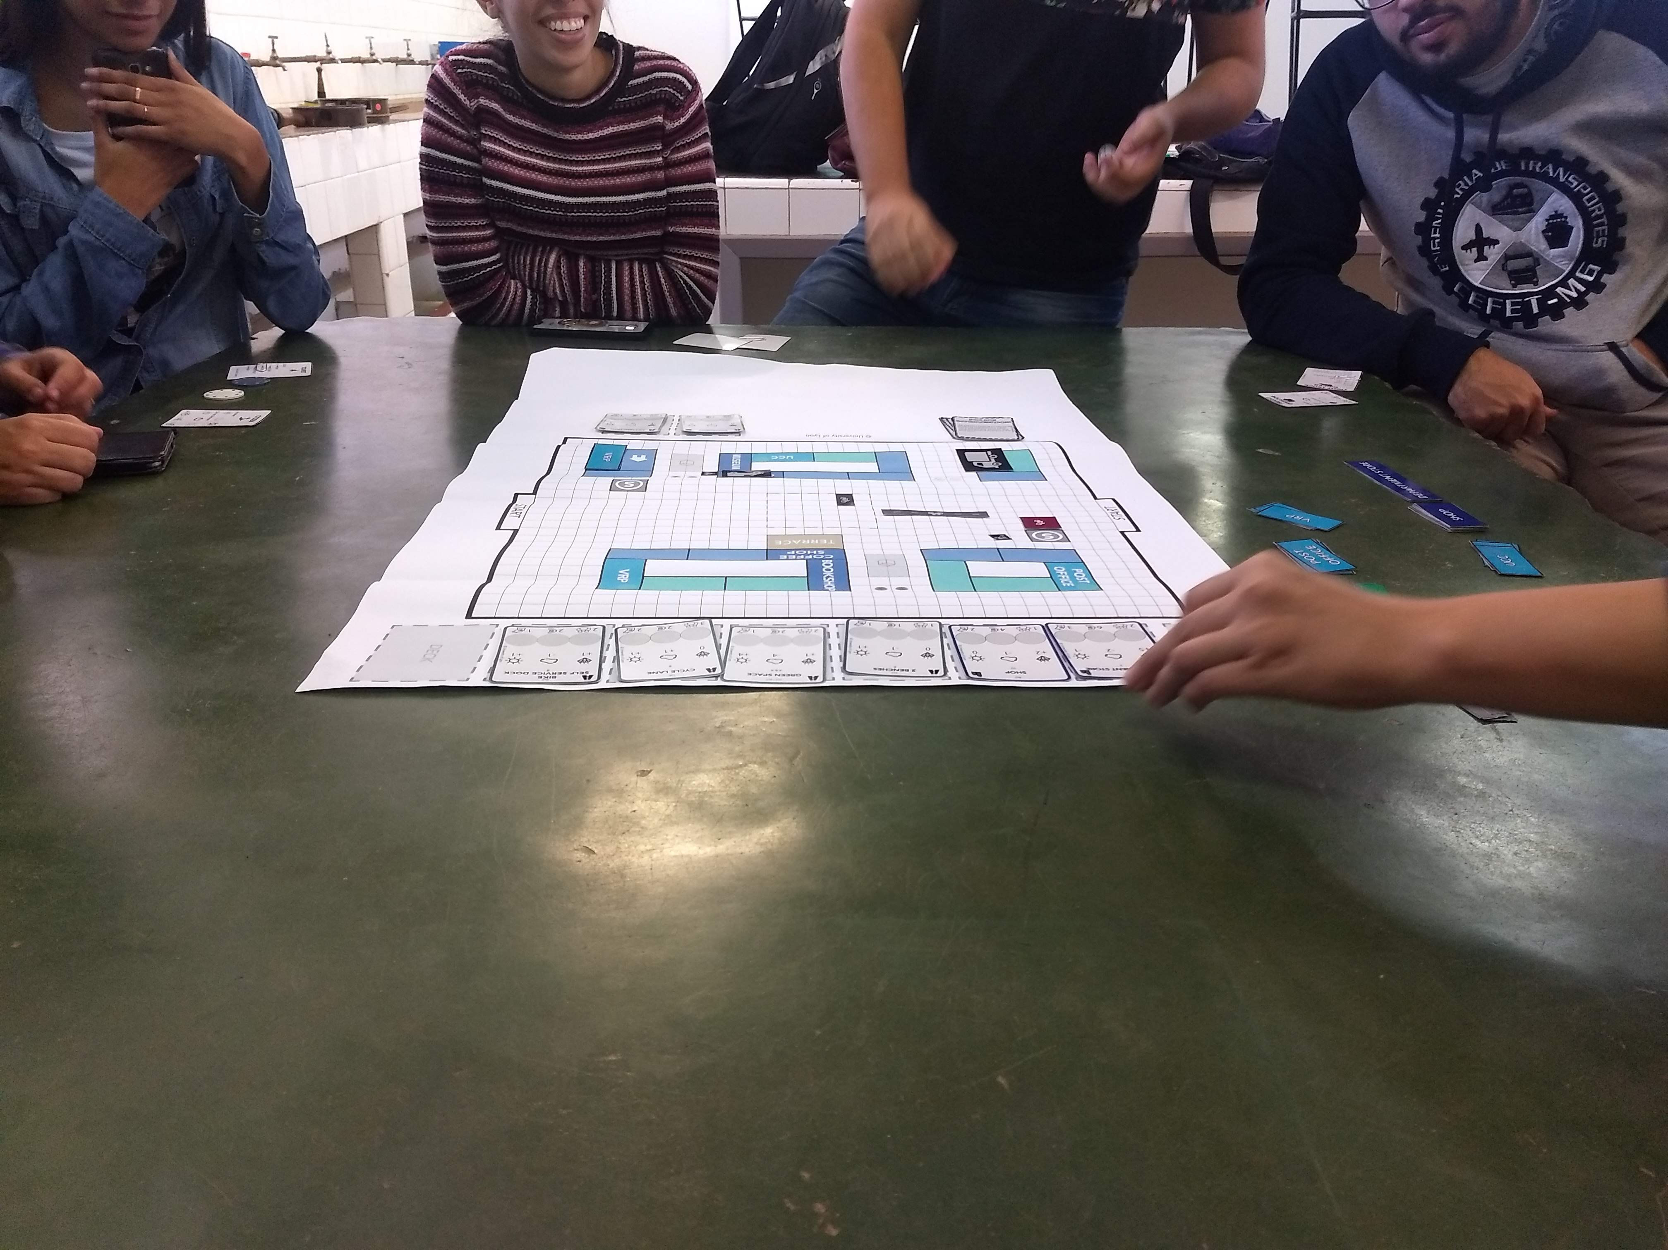
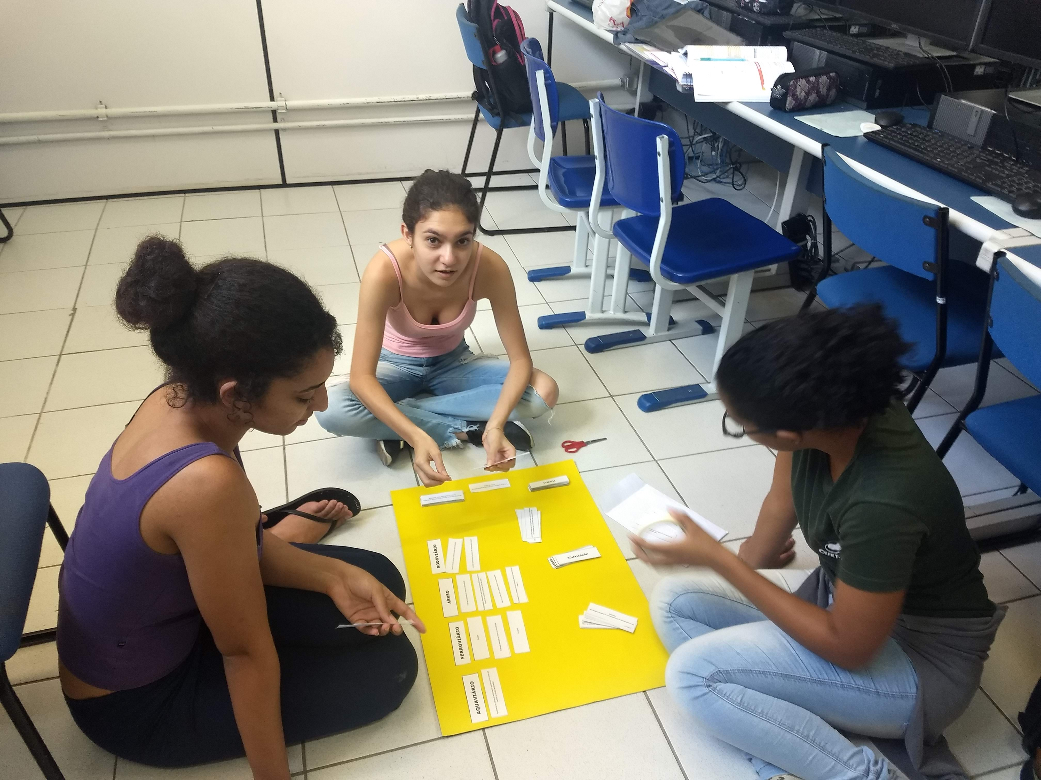
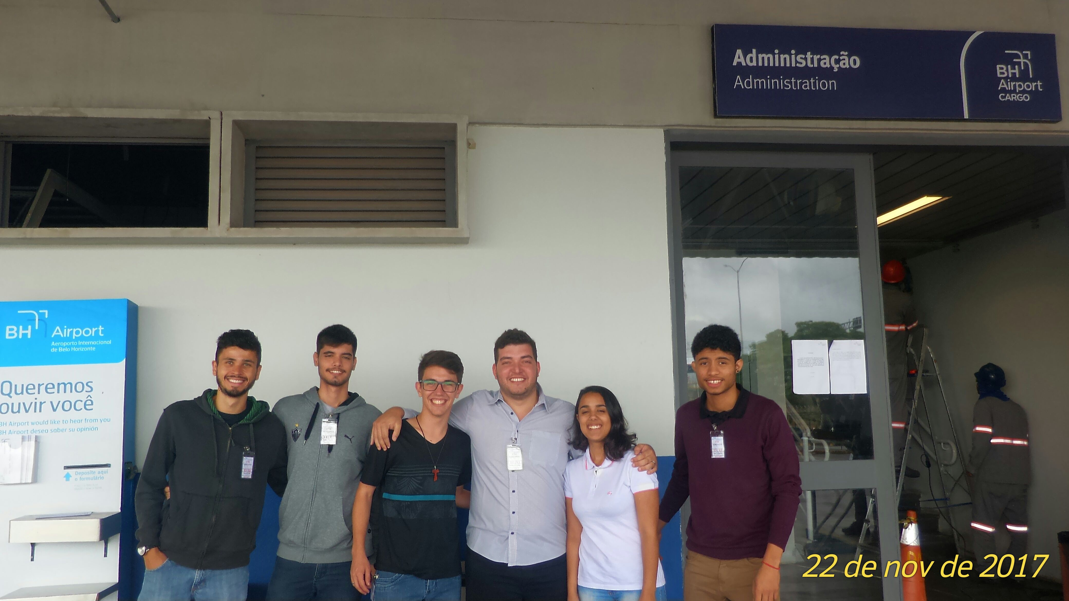

Slide 12
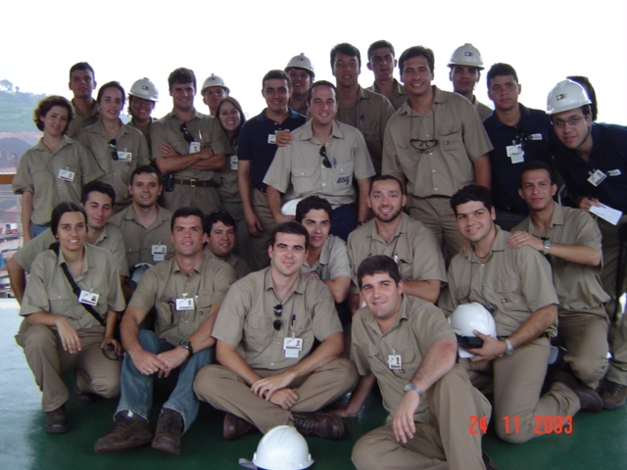

Slide 13
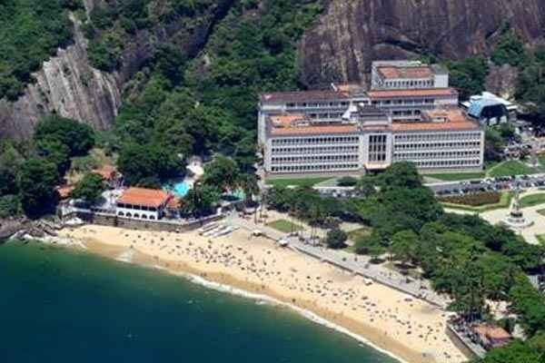

Slide 14
Urban happiness
Decision science
Urban Logistics
Data analytics
Sustainability
Inequality investigation
Accessibility-oriented planning
Safety and security
Human-scale cities
PEOPLE
EQUITY AND
QUALITY OF LIFE
Walkability and livability
Spatial analysis and Geocomputation
Impact assessment and Causal inference
Access to urban functions
Access to goods
Access to food
Measures of access
Land-use regulation and access to housing
Urban mobility systems
Living Labs
Urban morphology
Cities as complex systems

